Slide 1
CODE INNOVATION SERIES
TEAM:
ACCESS DENIED

Slide 2
PROBLEM STATEMENTNT
Enabling a patient-centered information exchange system.

Slide 3


OUR SOLUTION
BLOOD BANK WEBSITE

Slide 4
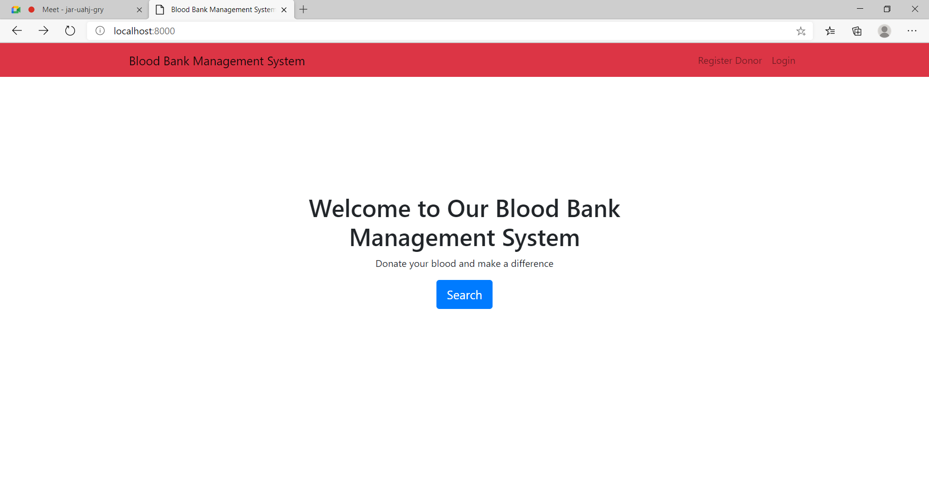
This is how our website looks like

Slide 5
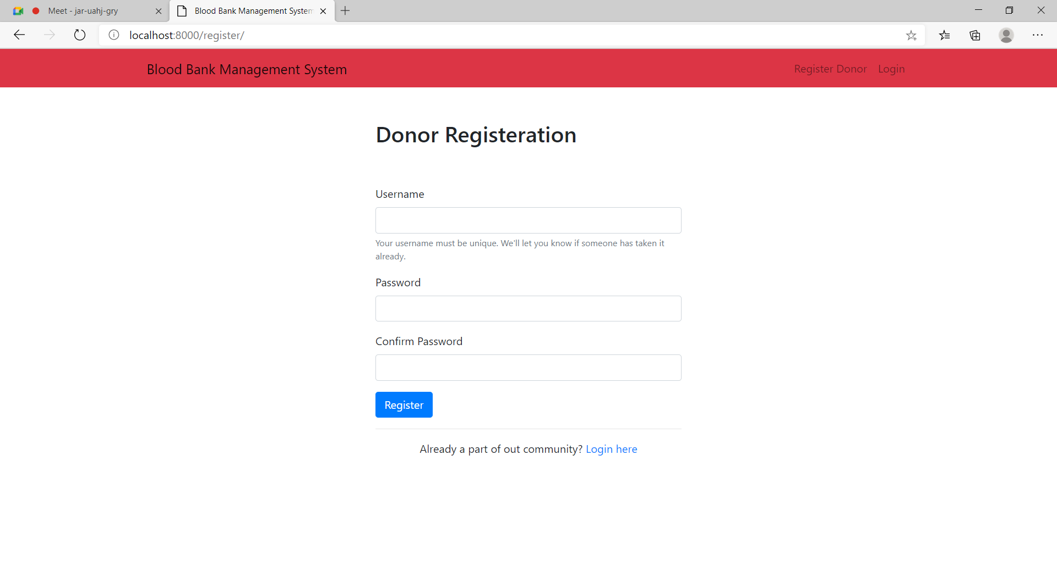
ewgg
This is the donor registration page

Slide 6
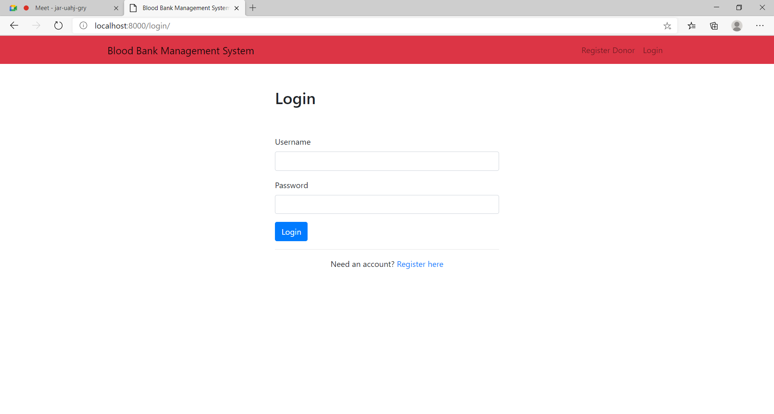
dfath
This is the login page of our blood bank website

Slide 7
OBJECTIVES:-
The Project is a Blood Bank website
users can view the information about registered blood donors along with their details of blood group and other medical information of donor.

Slide 8

The user can login and view the availability of blood and may also register to donate blood if he/she wishes to.
The location services enable the user to find nearest blood donor.
The main aim of developing this website is to reduce the time that is spent in searching for the right donor and the availability of blood required.

Slide 9
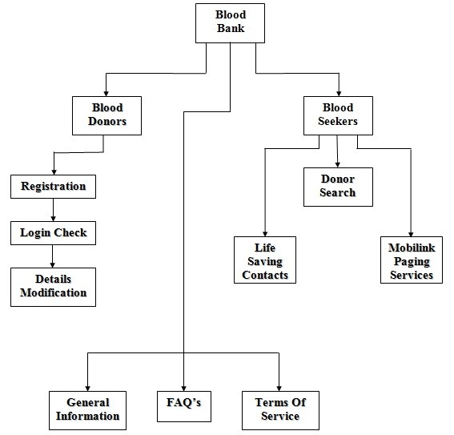
WEBSITE-FLOW DIAGRAM

Slide 10

TECHNOLOGIES USED:
Frontend:
Html
Bootstrap
Backend:
Django

Slide 11

CONSTRAINTS
Needs proper network connection
Uncertainity of donor availability

Slide 12


FUTURE SCOPE
This website will be linked by internet so the other hospitals can get the access
Website can be expanded with availability over worldwide
The website can also be implemented
into a mobile application
.

Slide 13
THANK YOU
OUR TEAM:-
ACCESS DENIED
PARVATHY REGHUNATH
NEEMA JOHN
PARVATHY DELEEP

